Slide 1
VAIDS-DSML exercise block 9
Jasmin Duvivié

Slide 2
simple linear regression
problem
1599 samples of wines
11 features
1 target: quality
1 feature as linear regressor: alcohol
solution
use sklearn.linear_model
construct model manually
plot observed and predicted values for both models
compare plots and ordinary least squares parameters

Slide 3
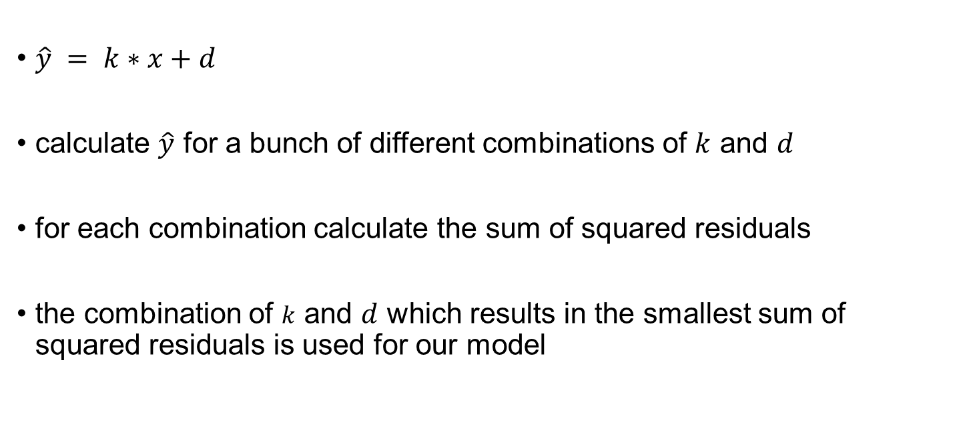
simple linear regression manually
$\hat{y} = k∗x+d$
calculate $\hat{y}$ for a bunch of different combinations of $k$ and $d$
for each combination calculate the sum of squared residuals
the combination of $k$ and $d$ which results in the smallest sum of squared residuals is used for our model

Slide 4
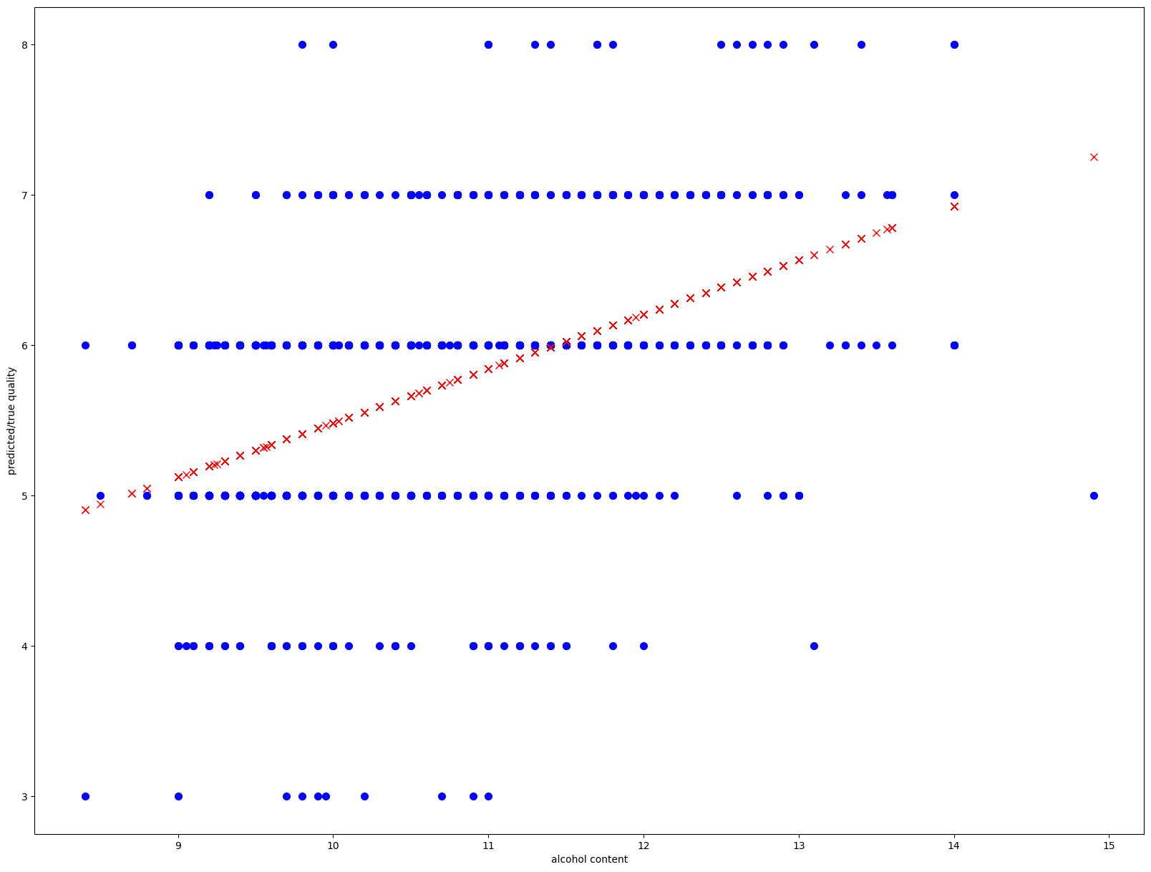
simple linear regression

Slide 5
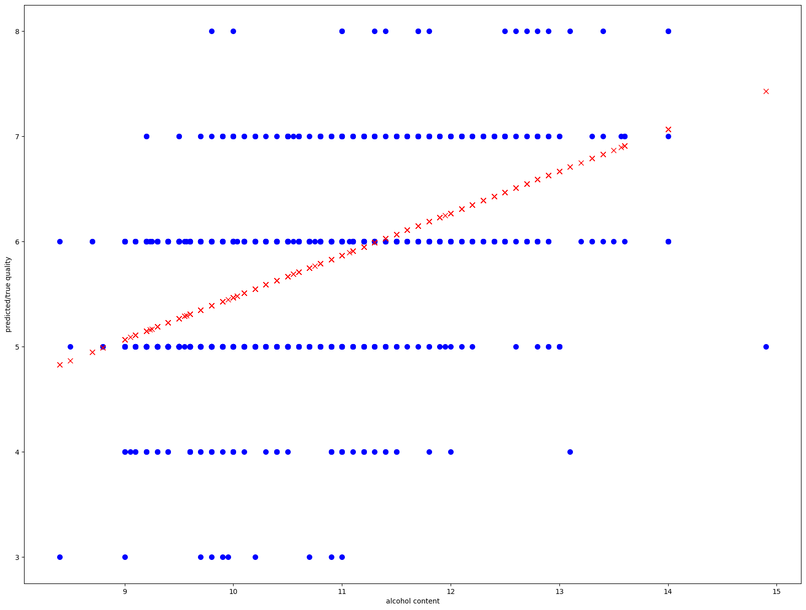
simple linear regression manually

Slide 6
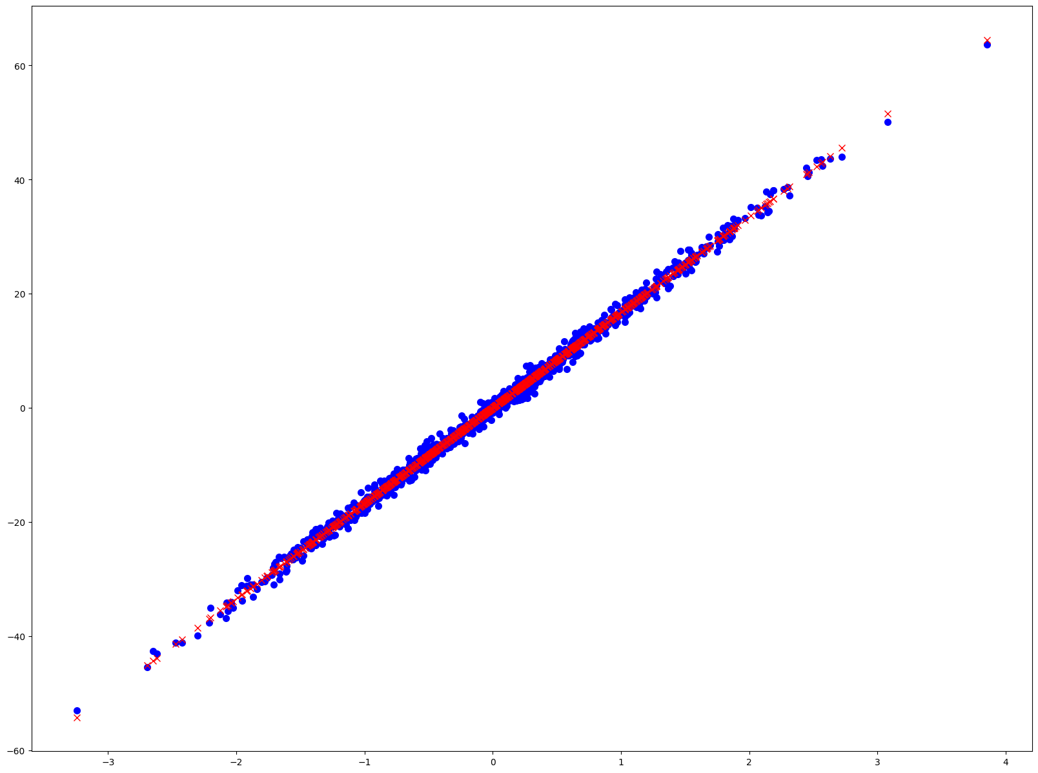
simple linear regression

Slide 7
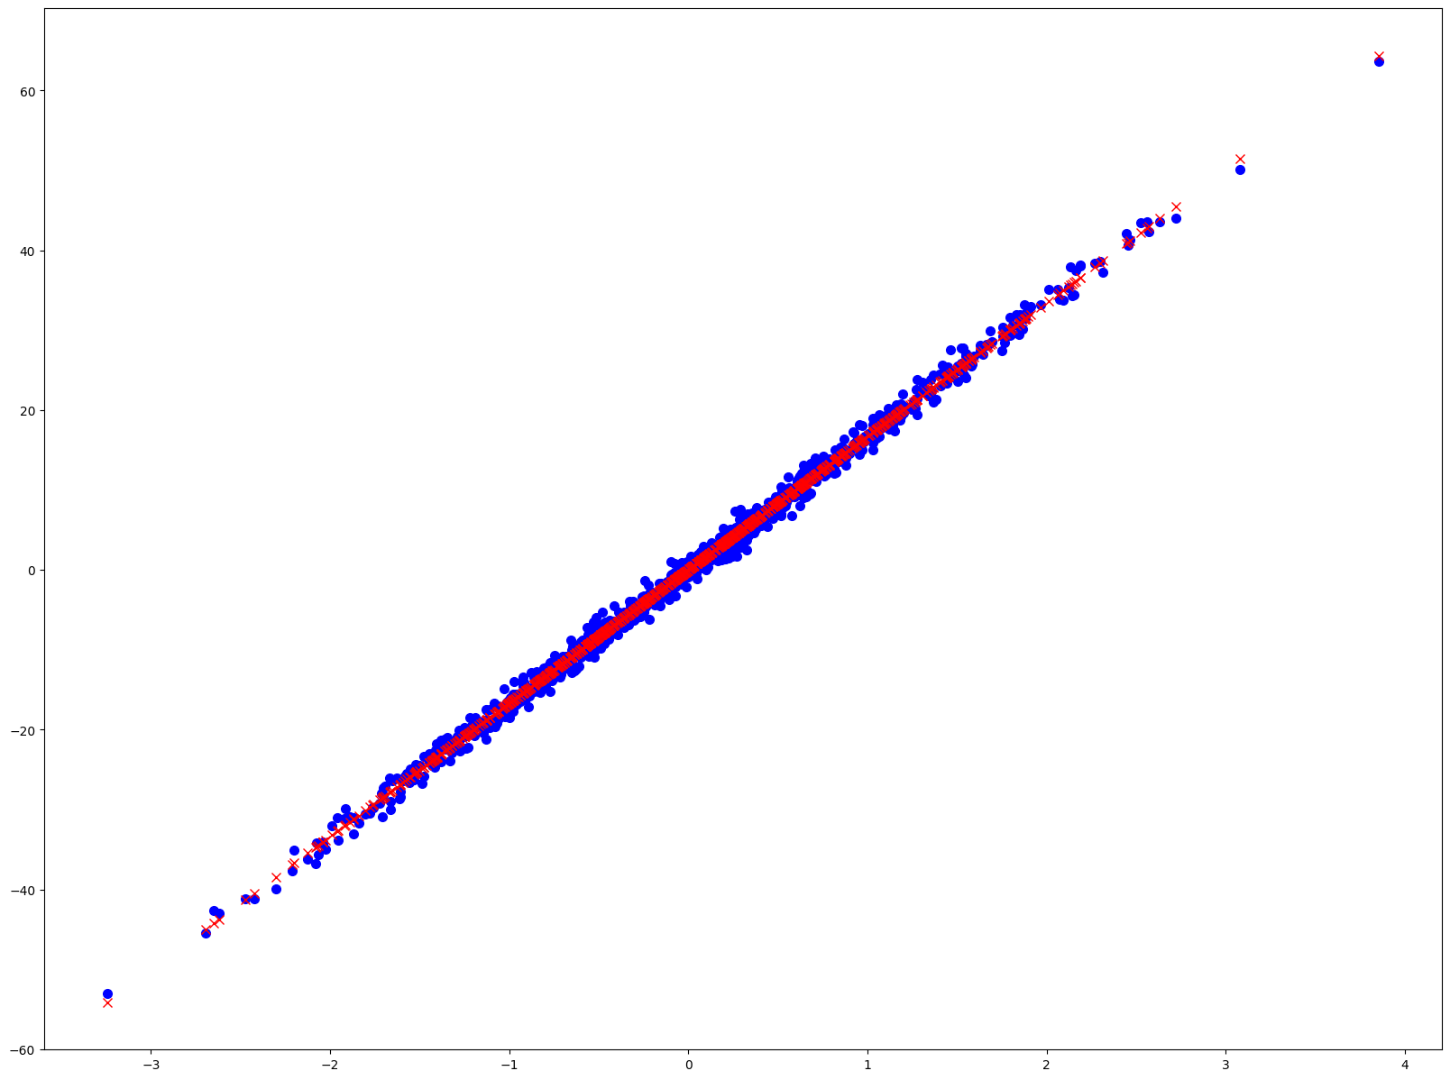
simple linear regression manually

Slide 8
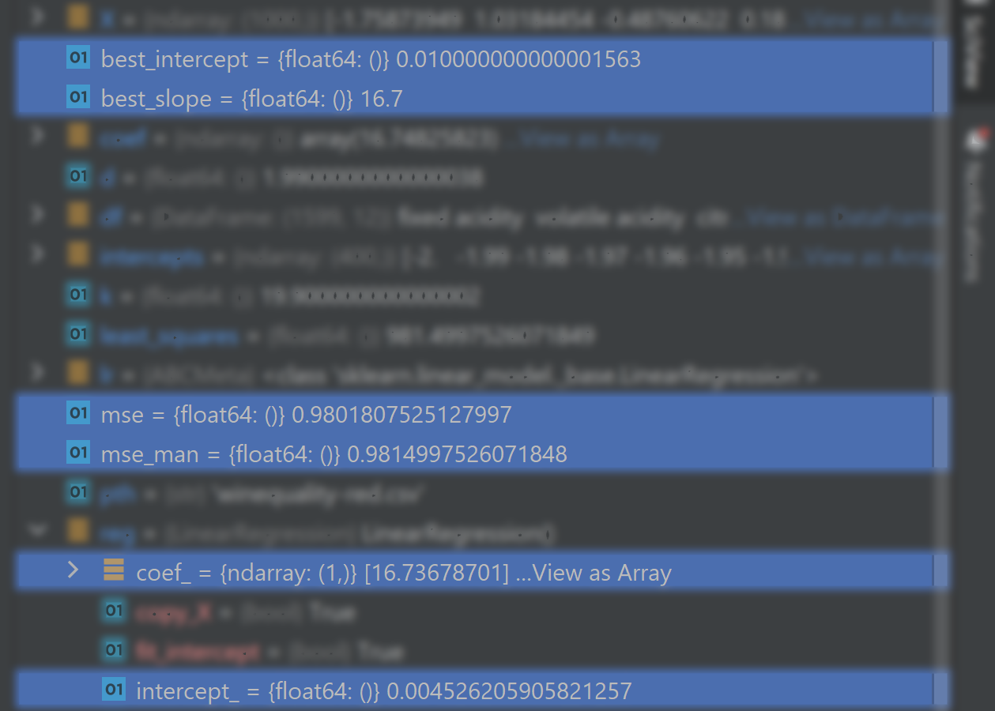
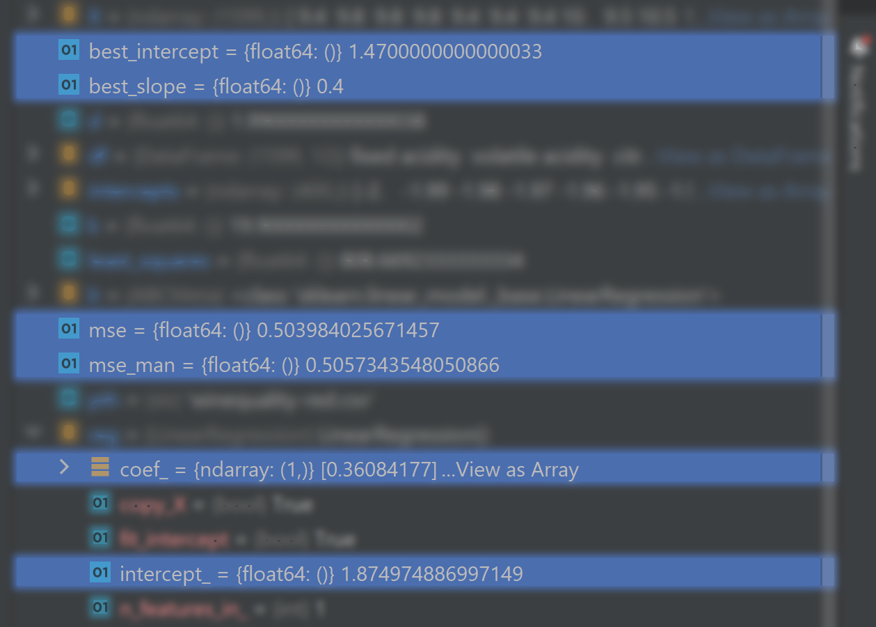
simple linear regression

